Slide 1
CS-210 PROJECT
BLUETOOTH CONTROLLED ROBO-CAR USING ARDUINO
ARKADEEP ACHARYA 2101AI41
ARITRA BHADURI 2101AI40

Slide 2

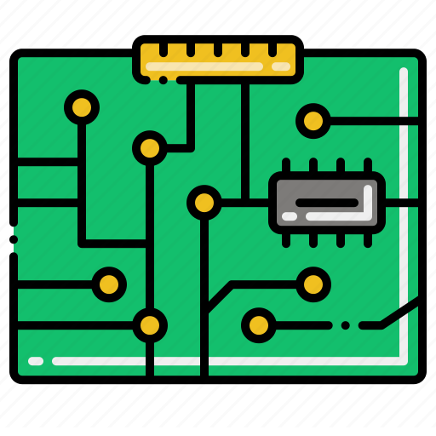




INTRODUCTION
COMPONENTS
CIRCUIT DIAGRAM
CONTENTS
ARDUINO CODE
ANDROID APP
CONCLUSION

Slide 3
INTRODUCTION
We chose to build a Bluetooth-controlled Robo-Car model using Arduino and the HC 05 bluetooth module that used an android app as its remote controller.
This was a group project of Aritra Bhaduri (2101AI40) and Arkadeep Acharya (2101AI41).

Slide 4
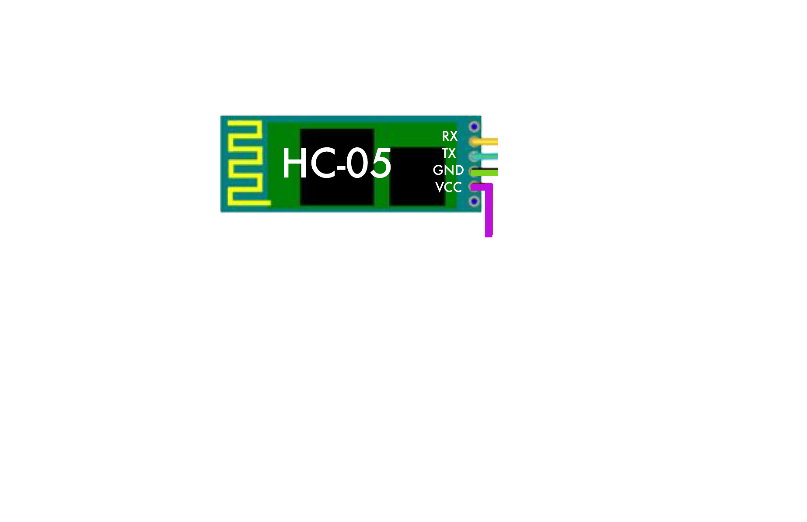
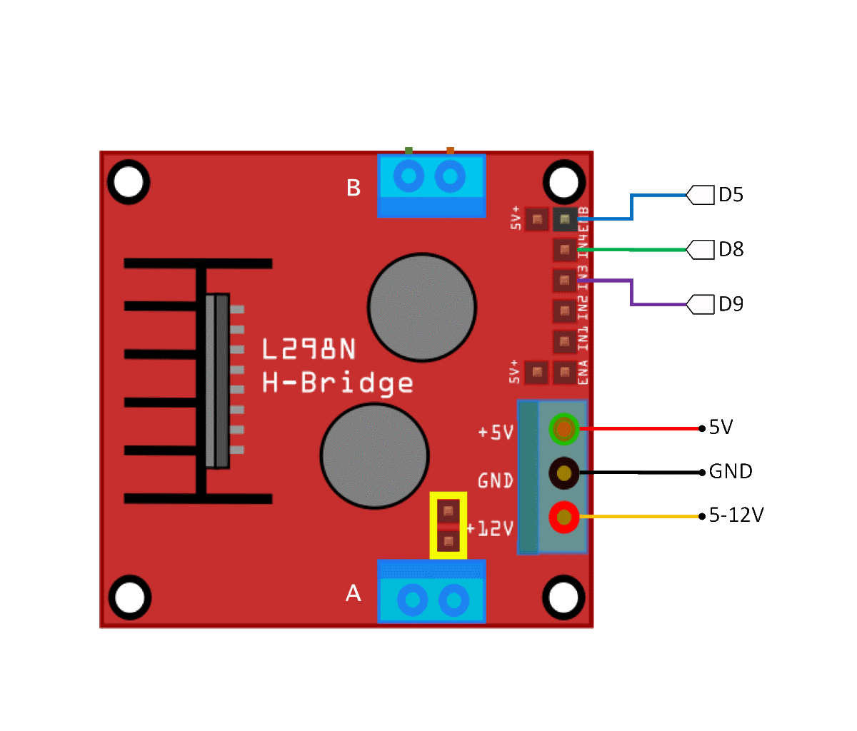
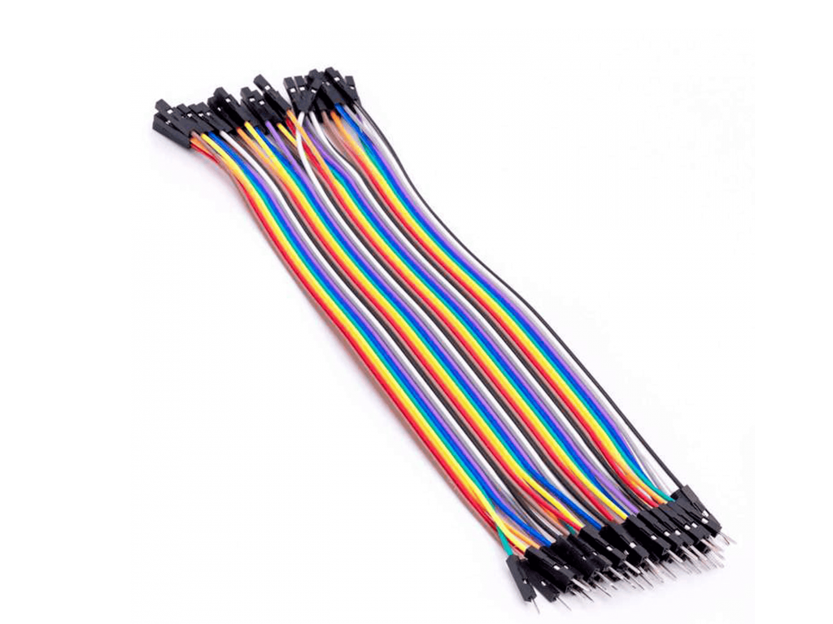
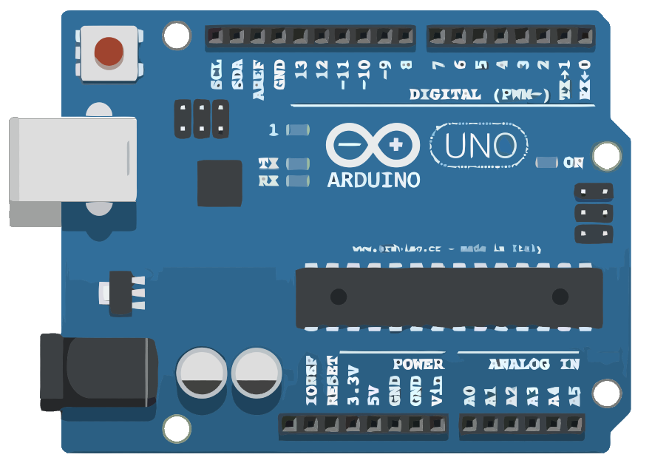
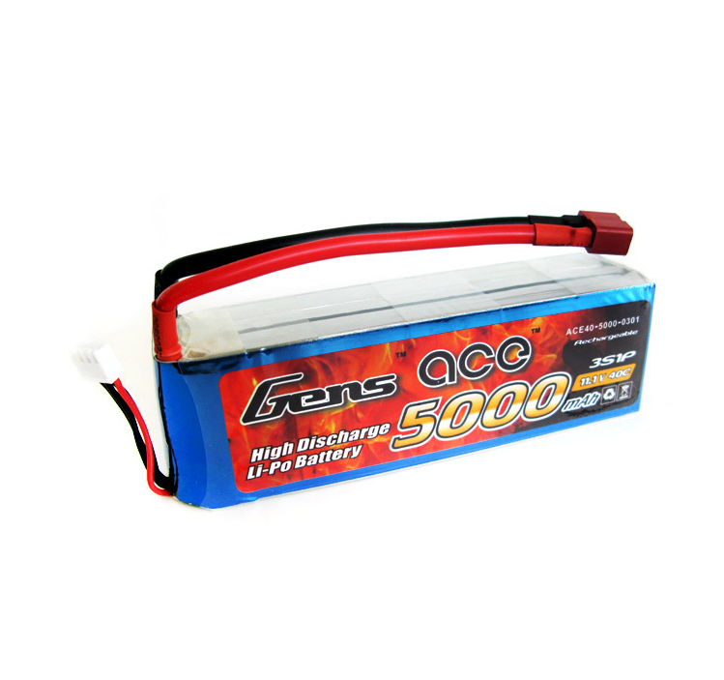
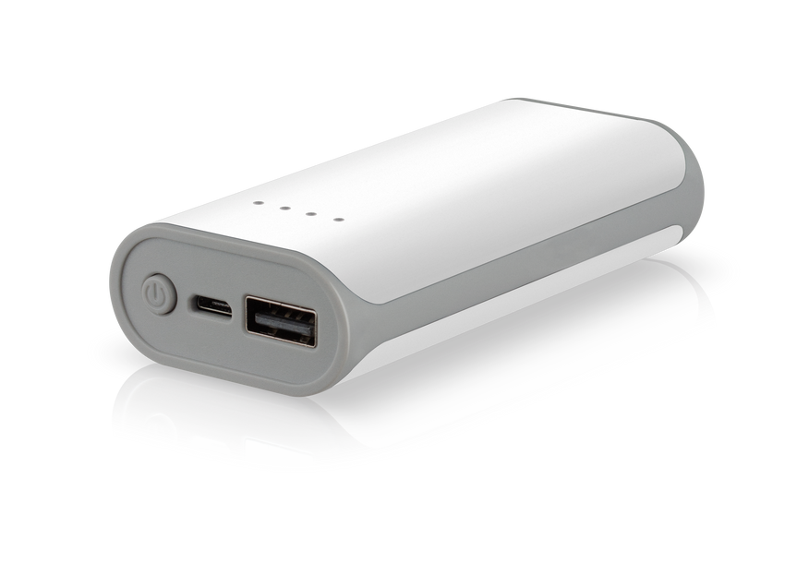
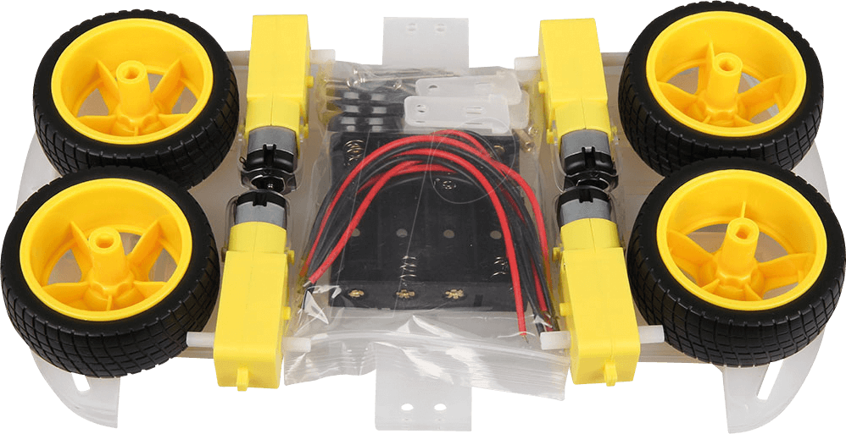
COMPONENTS
REQUIRED
Arduino Uno
L298 Motor Driver
HC-05 Buetooth Module
Jumper Wires
Car Chasis with 4 motors and wheels
Lipo Battery 12V
Power Bank

Slide 5
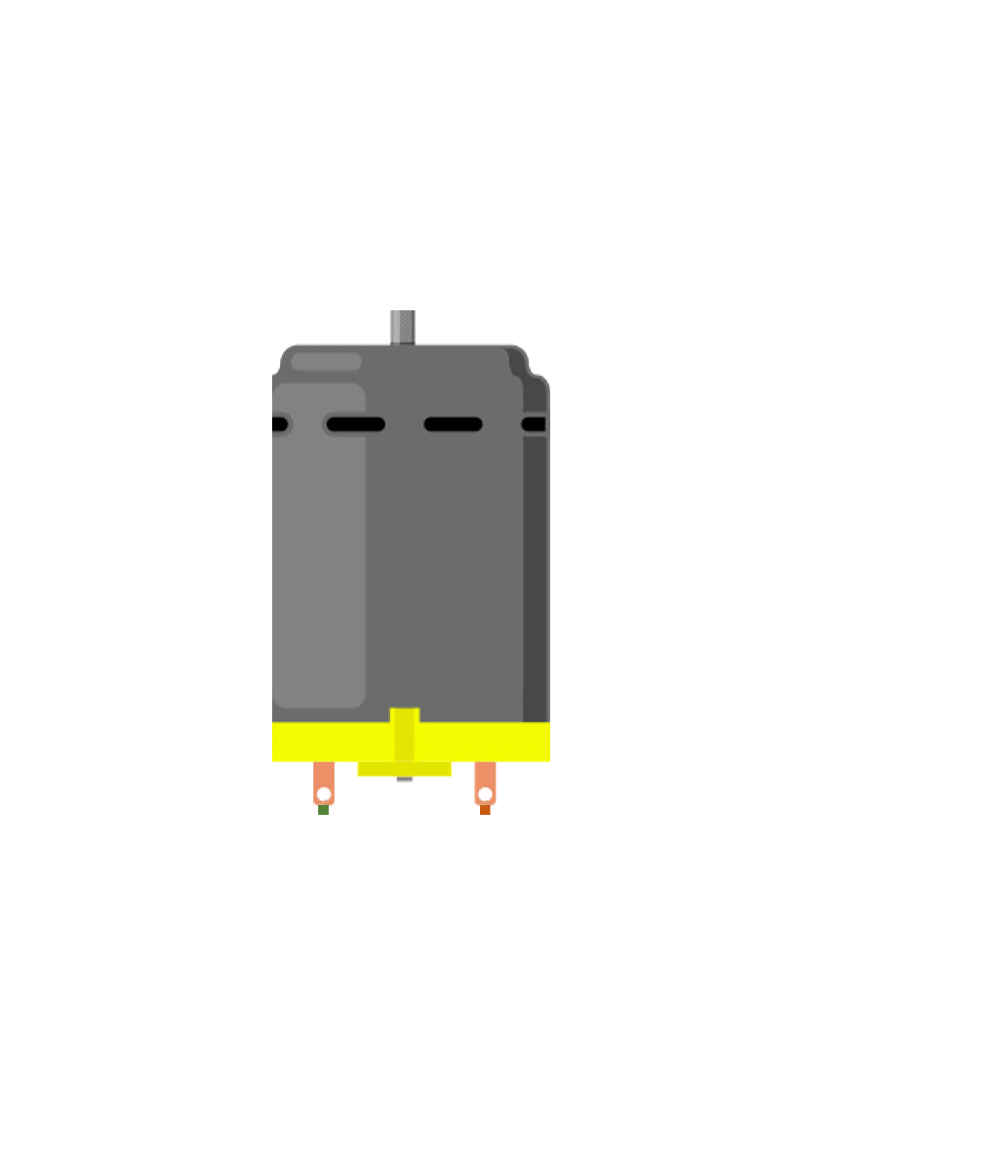
CIRCUIT
DIAGRAM

Slide 6
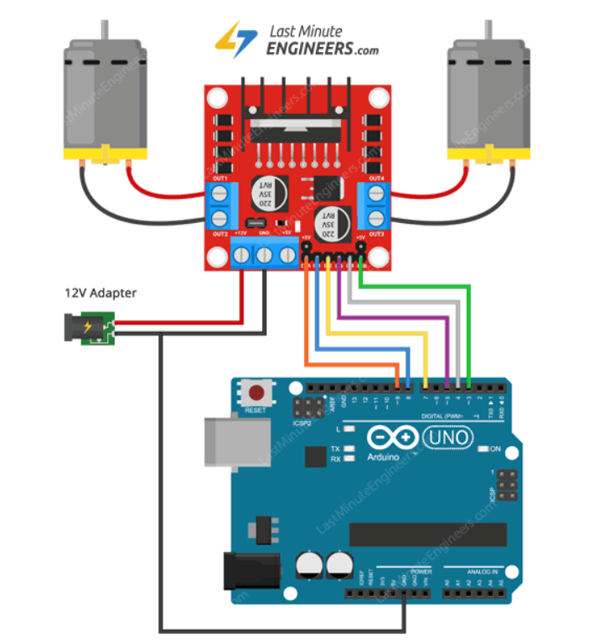
CIRCUIT
DIAGRAM

Slide 7
CIRCUIT
DIAGRAM

Slide 8
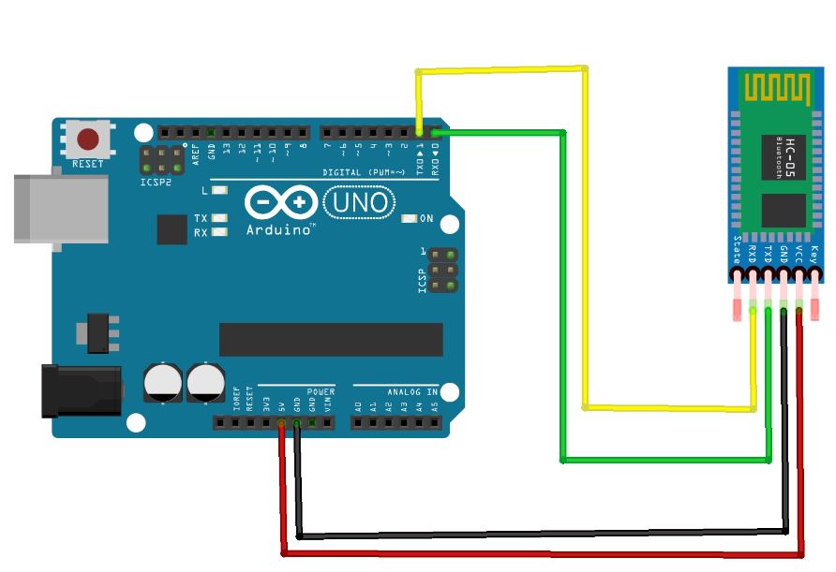
CIRCUIT
DIAGRAM

Slide 9
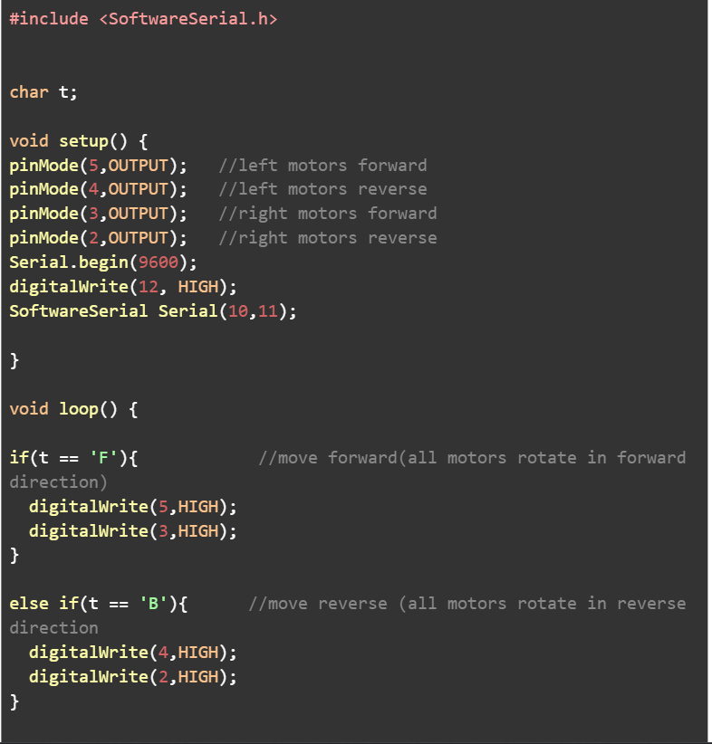
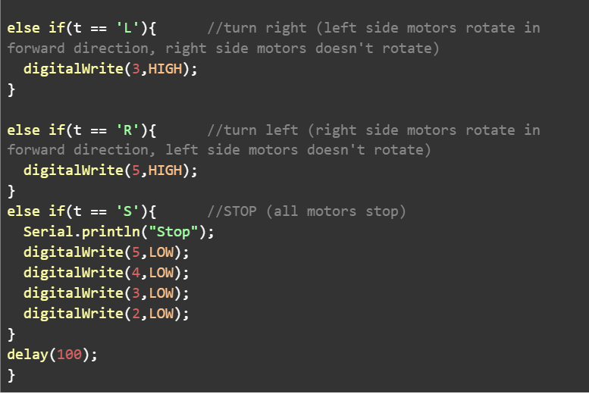
ARDUINO
CODE

Slide 10
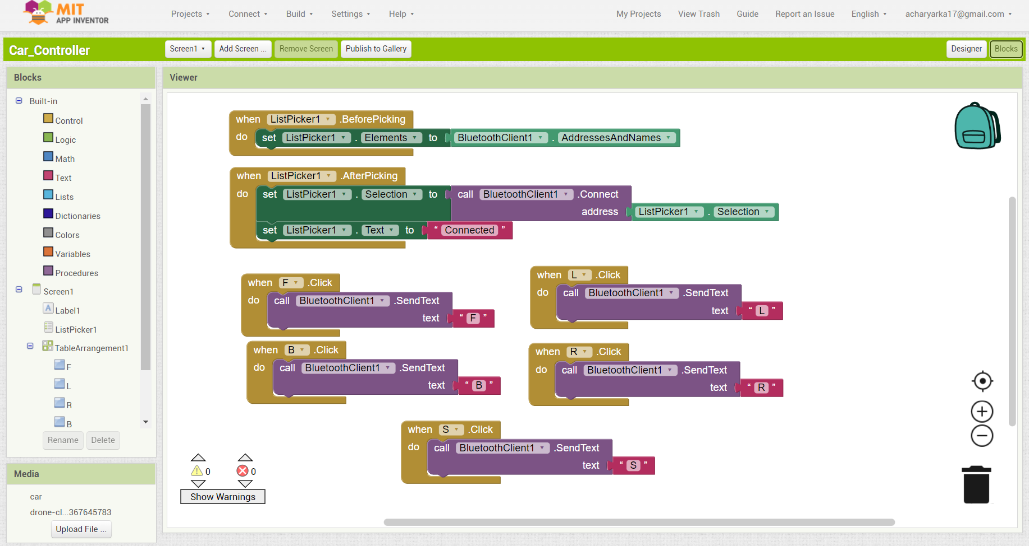
ANDROID
APP

Slide 11
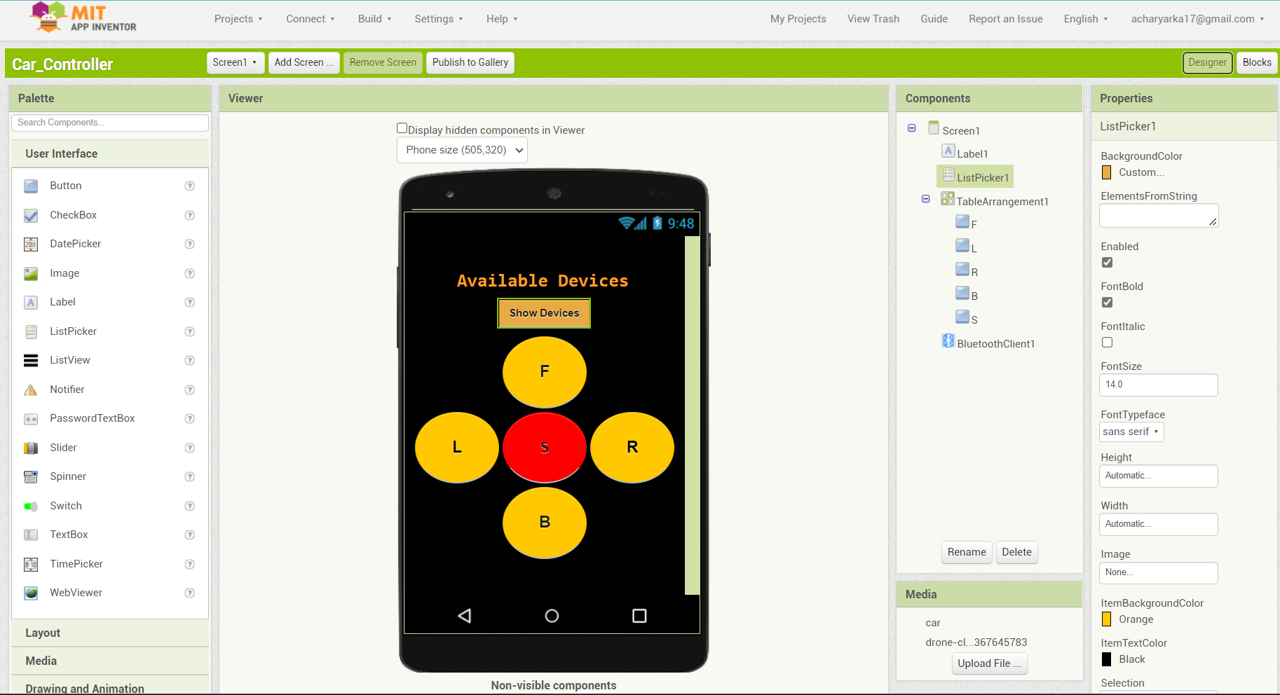
ANDROID
APP

Slide 12
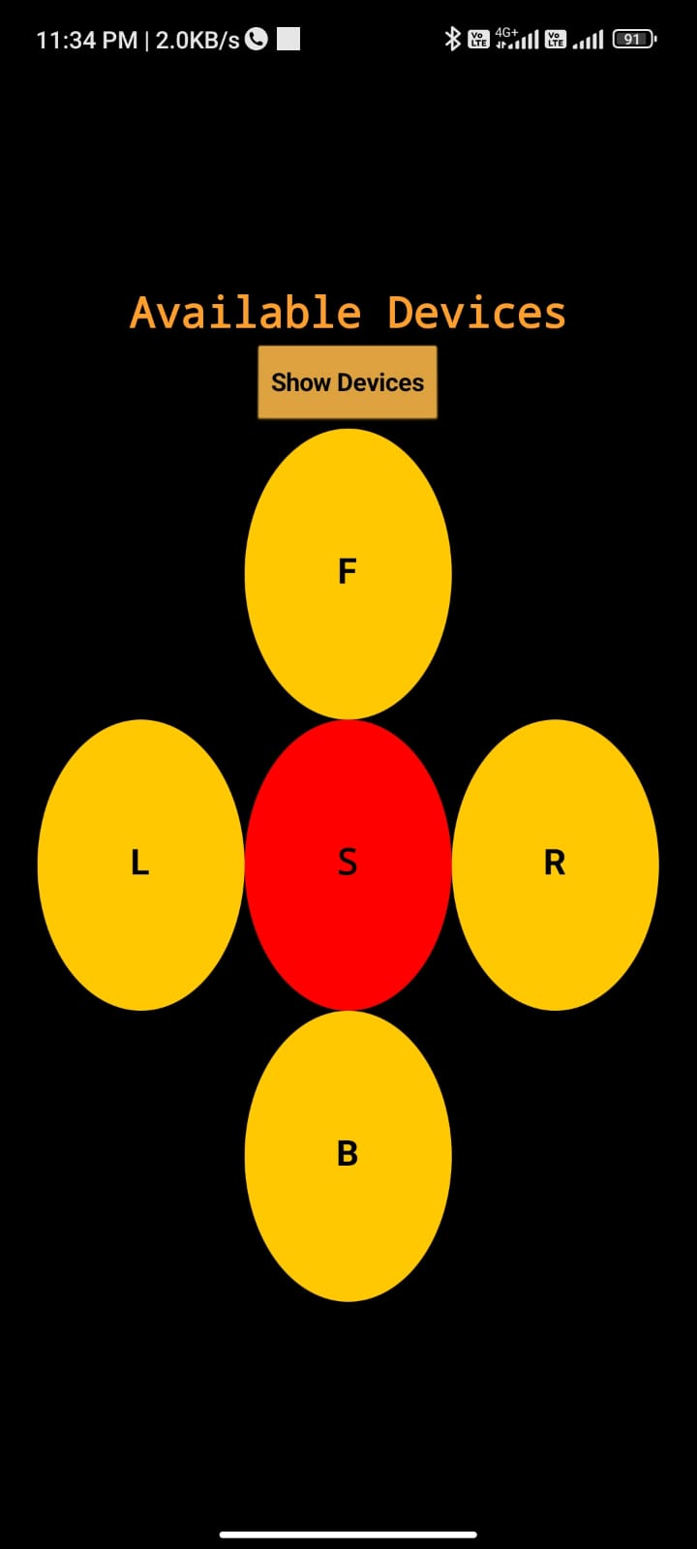
ANDROID
APP
FINAL APP

Slide 13
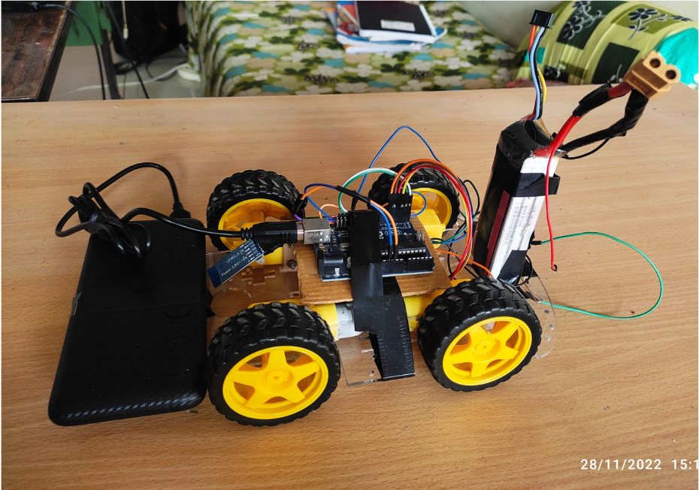
CONCLUSION
This hands on Arduino preject was a great learning experience for both of us. I helped us learn how we can write code Arduino code and make projects like this. It also mde us realise how different dealing with real hardware is and how things might not go as planned always and we need adapt to the various situtations that we face. We would like to thank Jimson Matthew sir for giving us an opportunity to work on such an exciting project.

Slide 14
THANKS

